Slide 1
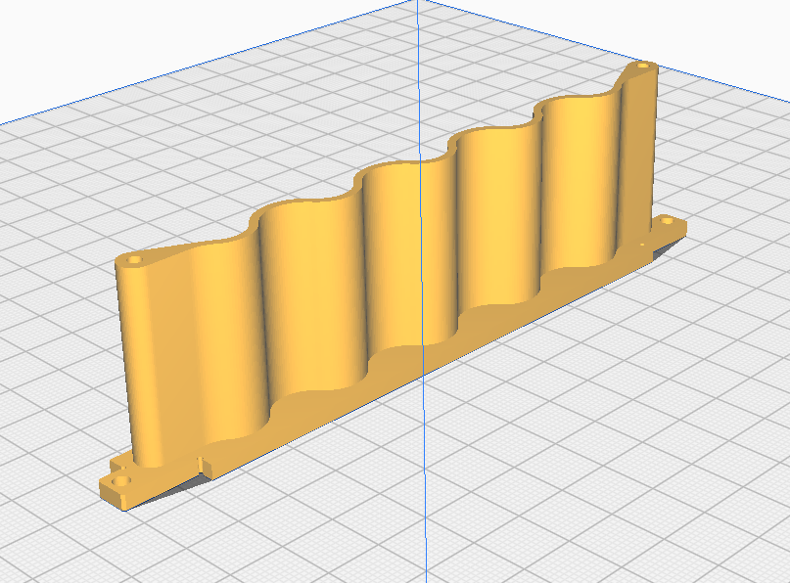
Ambient_LED_Screen

Slide 2
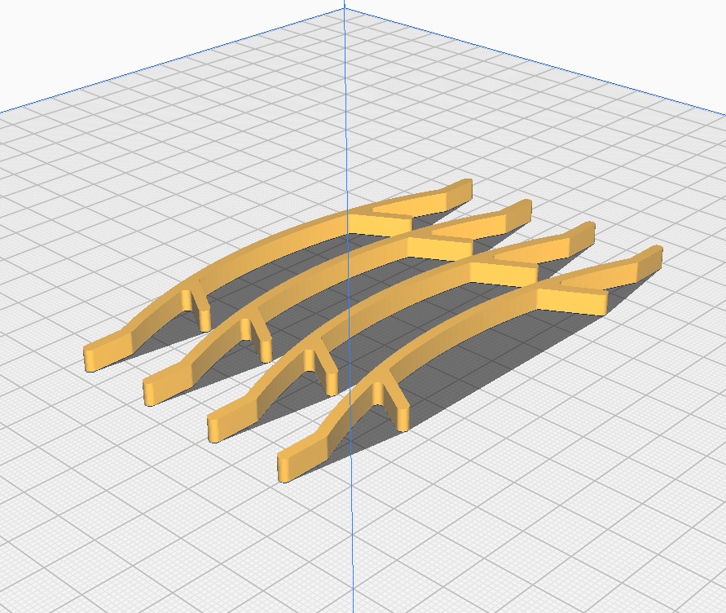
Carrier_Clamps (4 pieces)

Slide 3
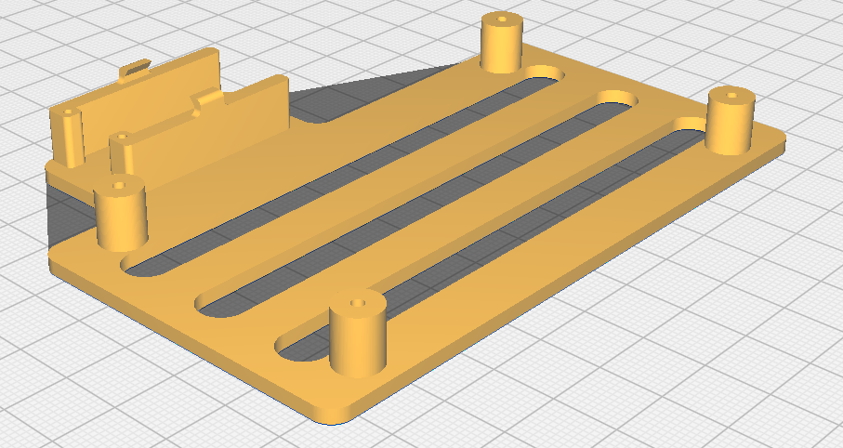
ConnectorBoardv2-Mod_Carrier

Slide 4
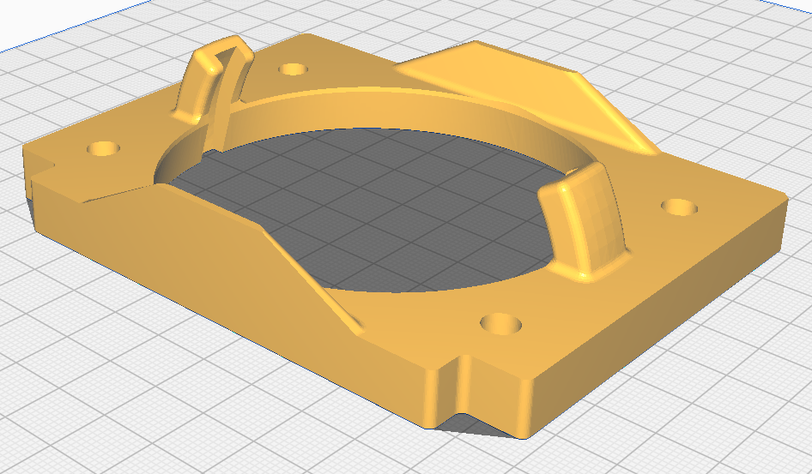
EyeScreen (print 3x)

Slide 5
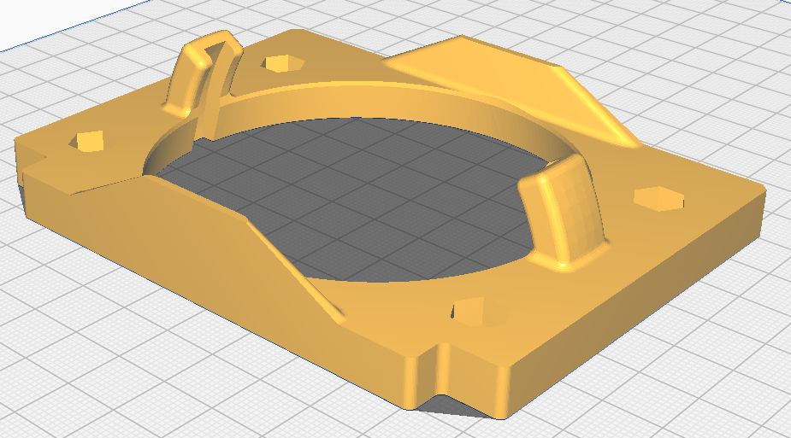
EyeScreen_Clamp (print 3x)

Slide 6
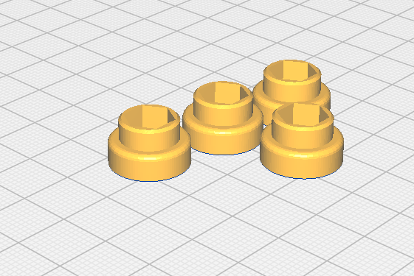
Foot (4 pieces)

Slide 7
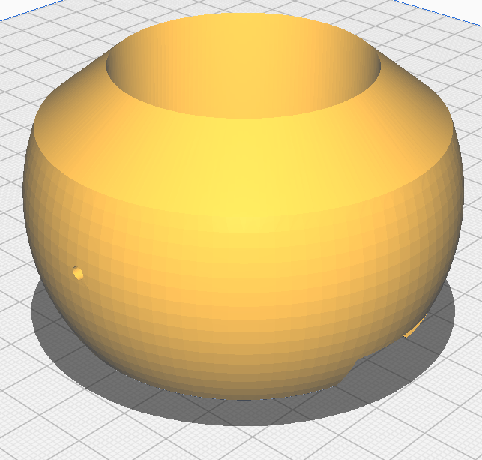
IMX296-MPI_Eyeball_6mm (print 2x)

Slide 8
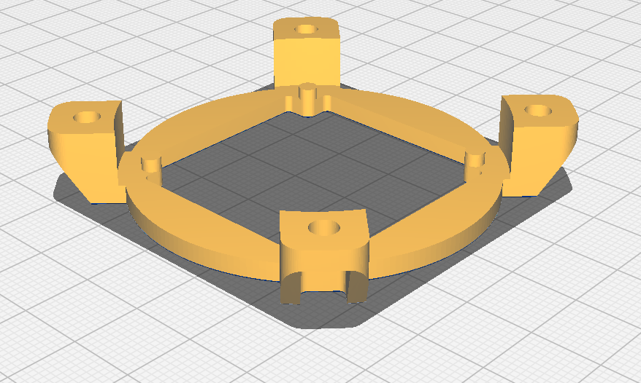
LED_Clamp

Slide 9
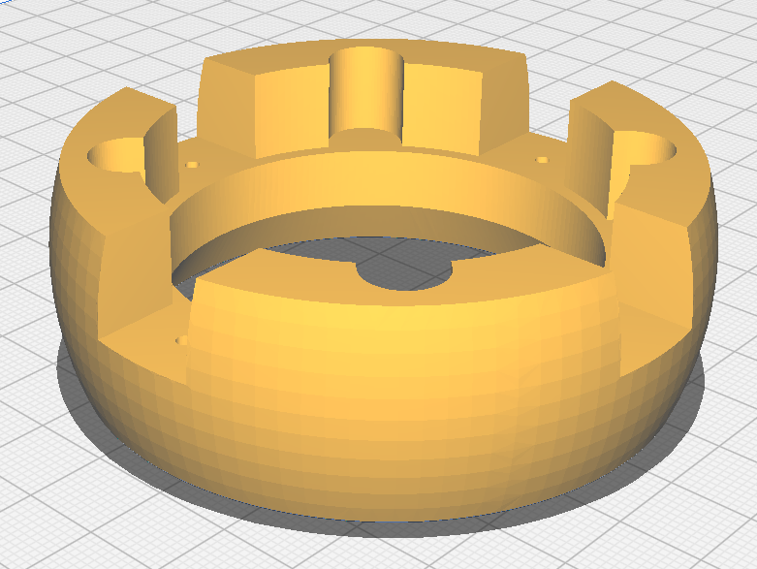
LED_Eyeball

Slide 10
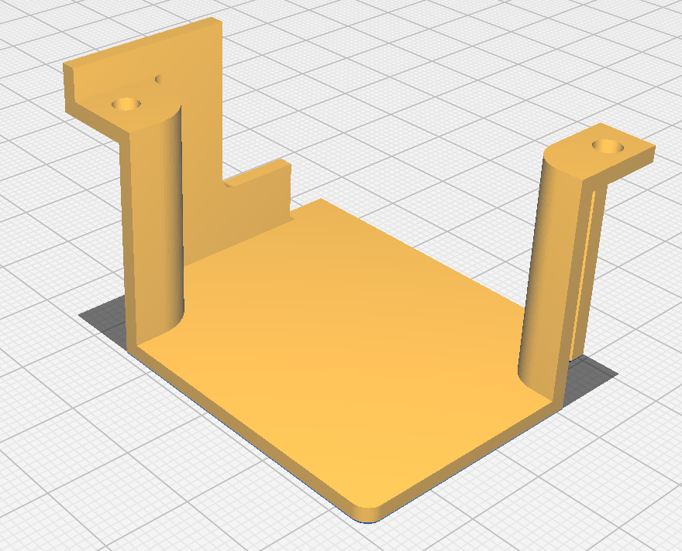
LinePower_Cover

Slide 11
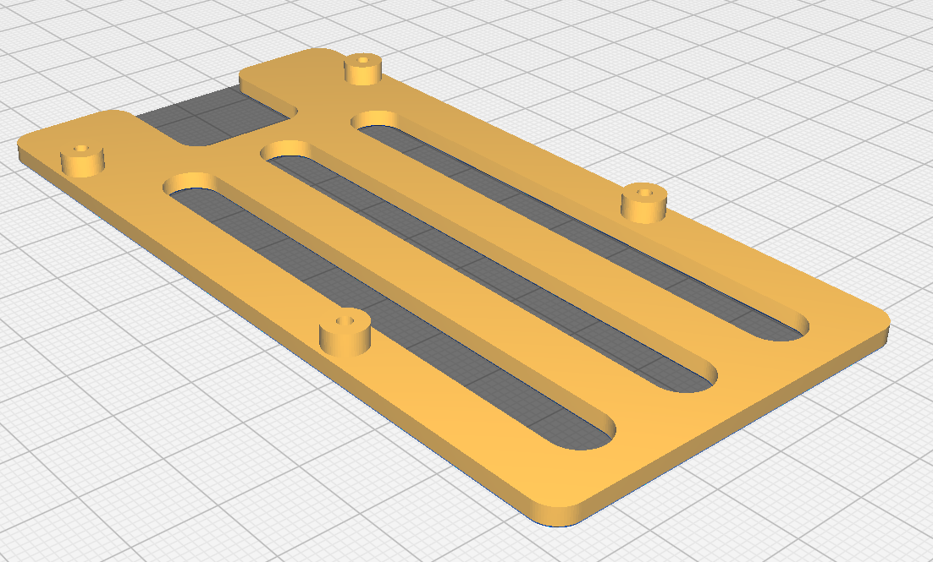
Pi5_Carrier_3mm

Slide 12
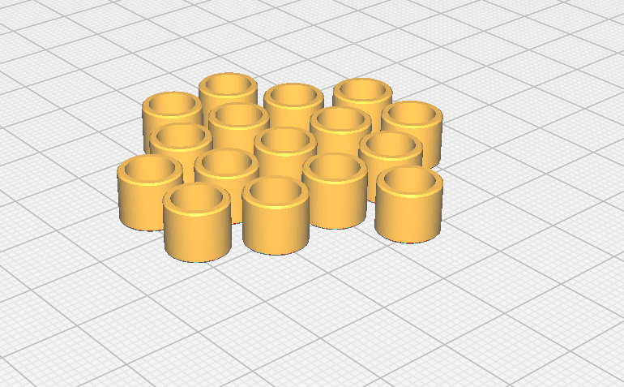
Spacer (16 pieces)

Slide 13
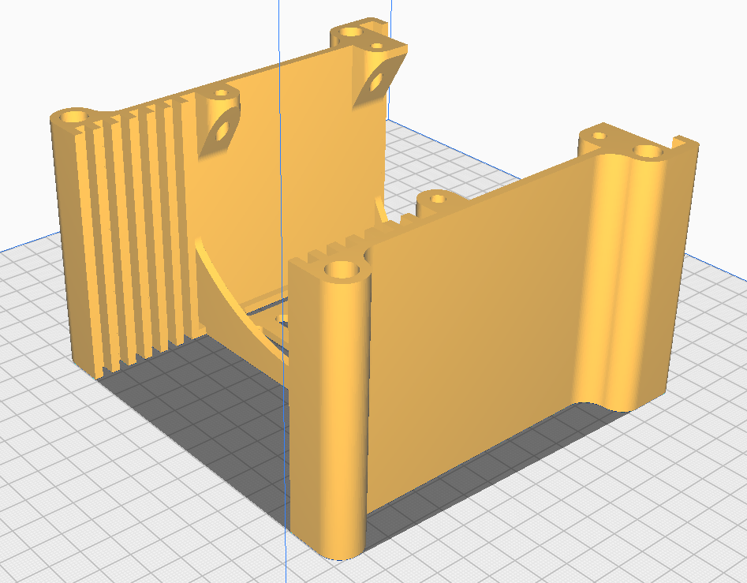
Stack_Module (print 3x)

Slide 14
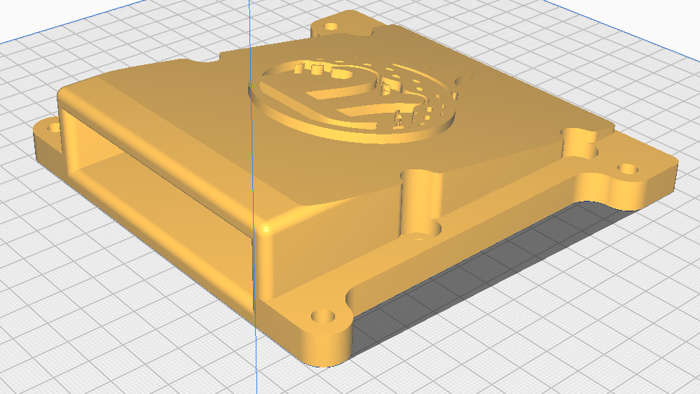
Stack_Module_Cover

Slide 15
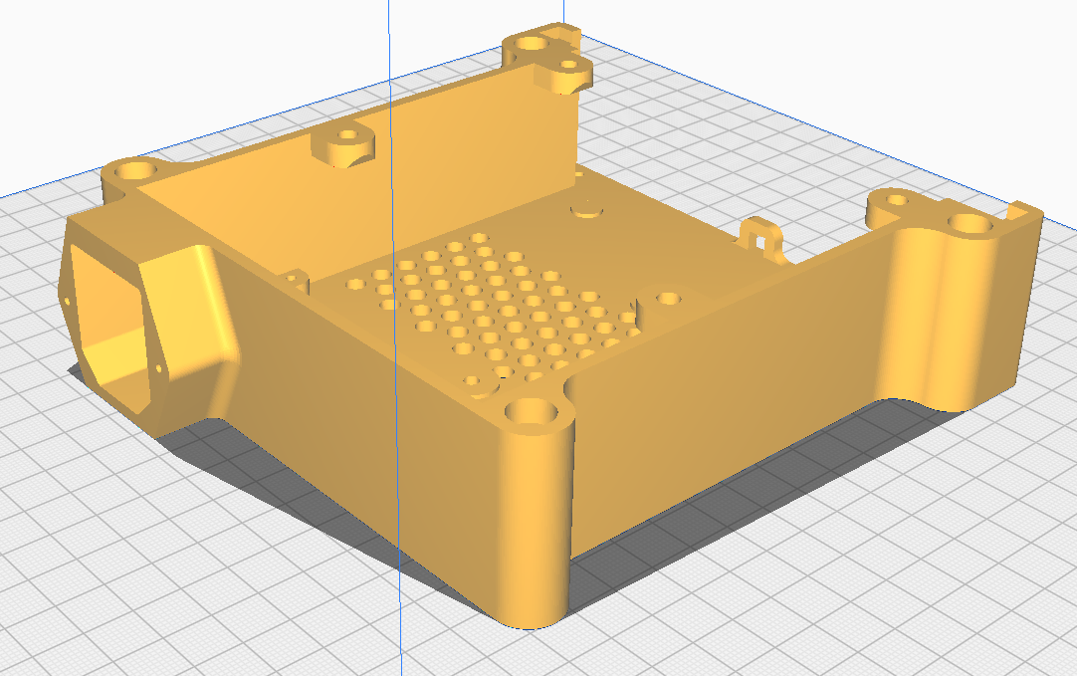
Stack_Module_PSU

Slide 16
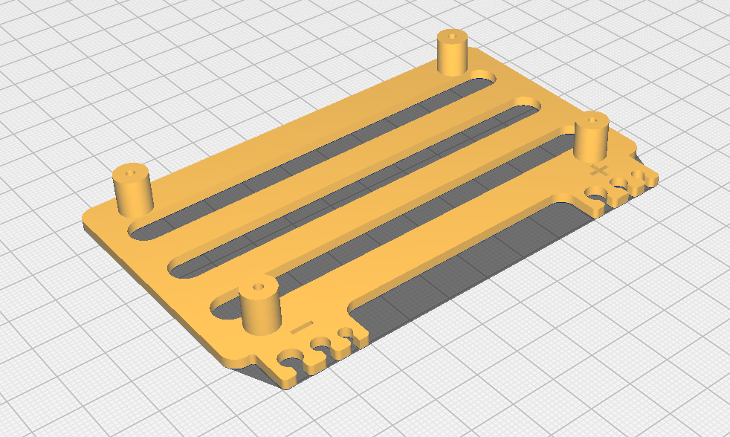
ConnectorBoardv3_Carrier

Slide 17
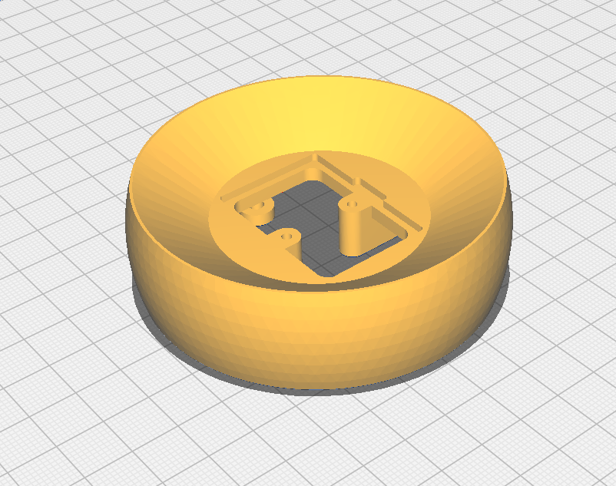
5x2IRLED_Eyeball

Slide 18
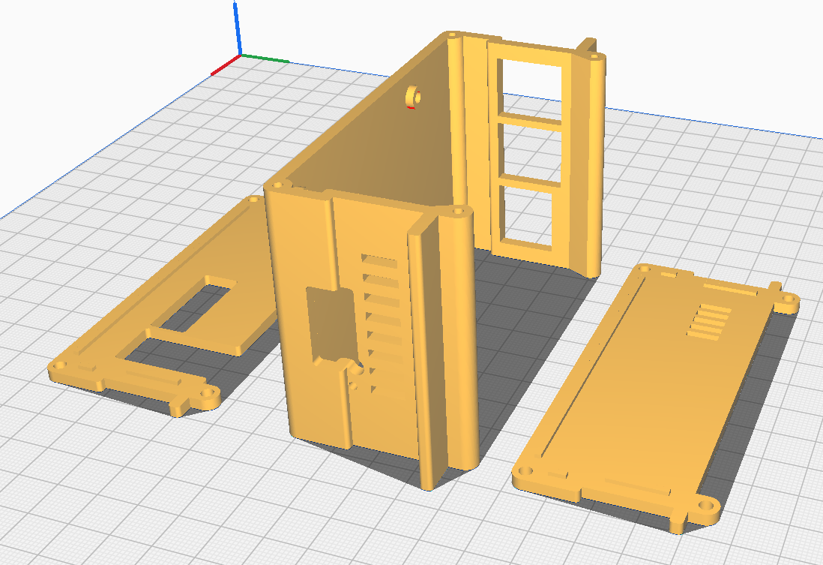
Pi5_Bagpack, _top, _bottom

Slide 19
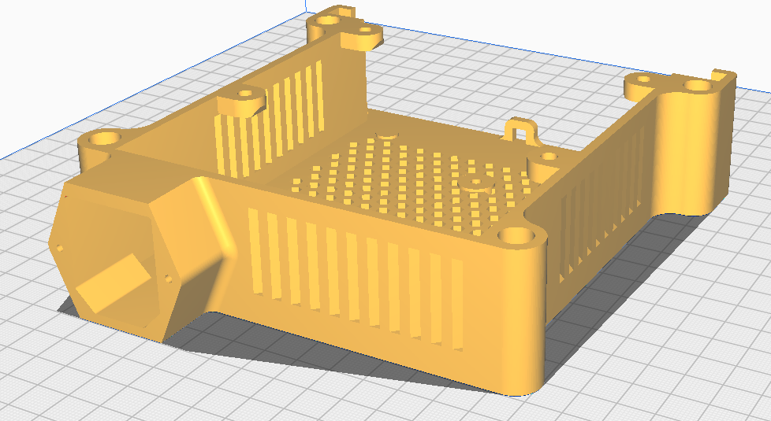
Stack_Module_PSU_vent

Slide 20
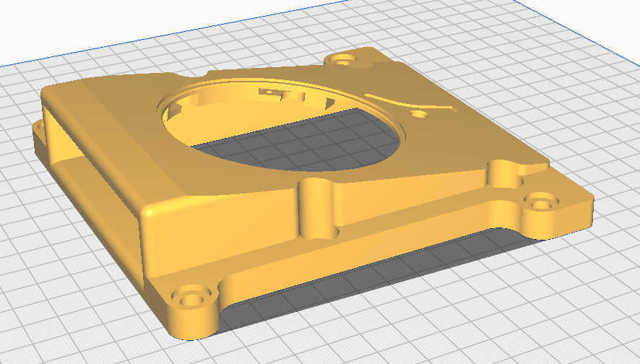
Stack_Module_Cover_forInserts

Slide 21
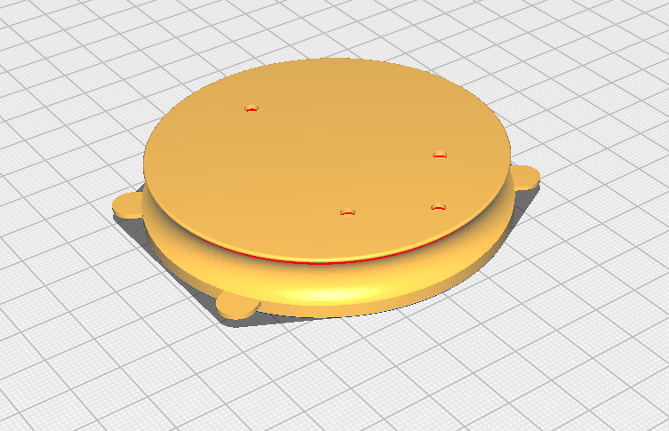
Stack_Module_Cover_insert

Slide 22
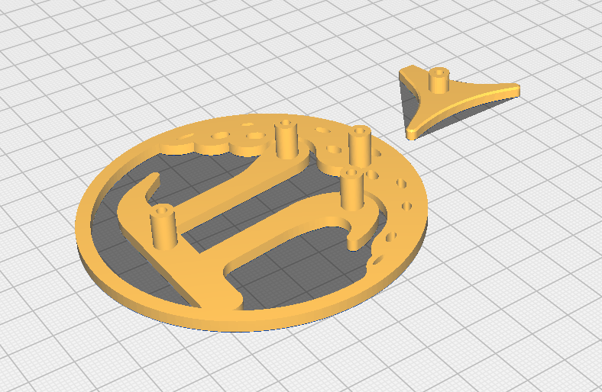
Stack_Module_Cover_LogoTee and _LogoBall

Slide 23
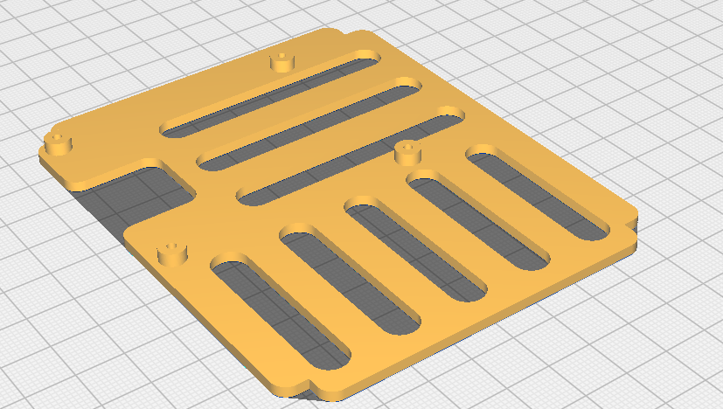
Pi5_Carrier_vertical_3mm

Slide 24
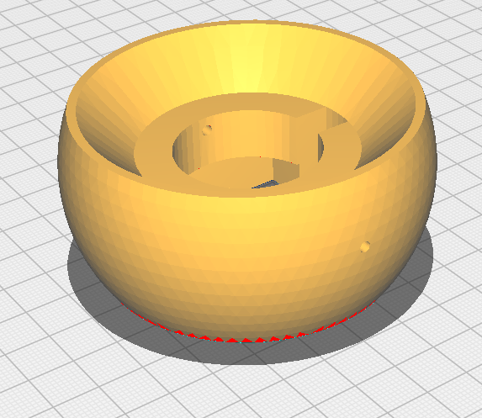
IMX296-MPI_Eyeball_6mm_camfered

Slide 25
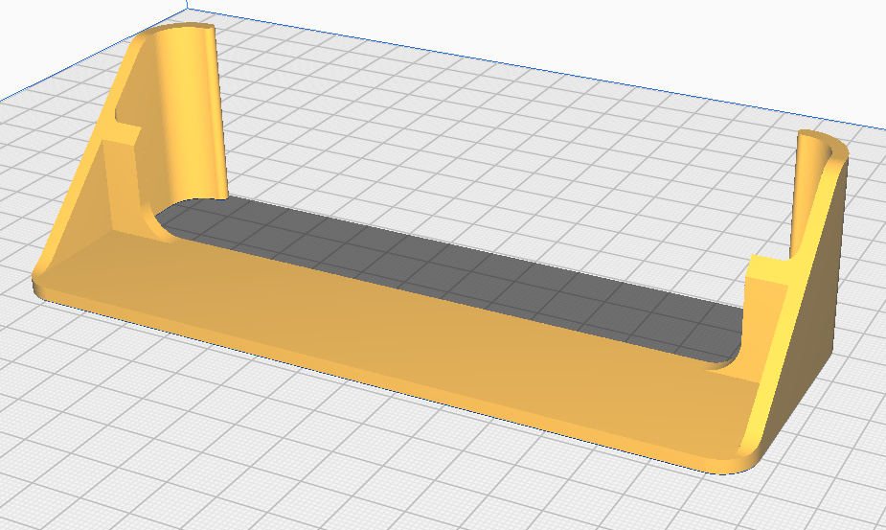
Ambient_LED_Visor

Slide 26
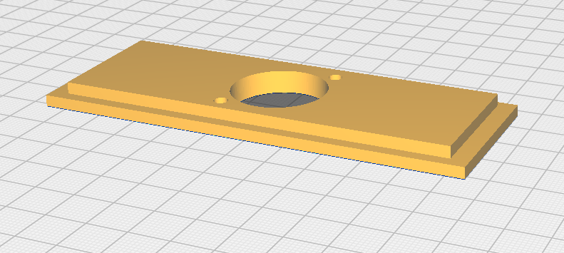
Back_Interface_Plate_Type_D_Bulkhead

Slide 27
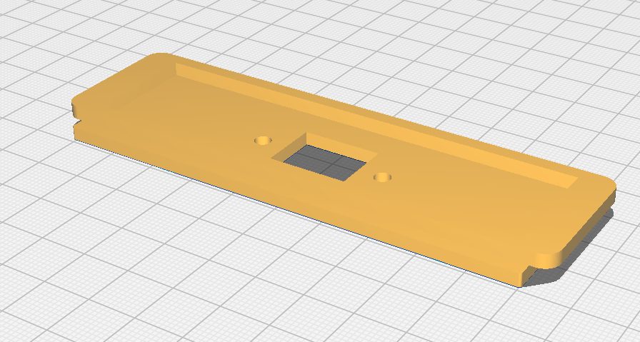
Back_Interface_Plate

